Slide 1

Node.js -Introduction
23 August, 2015
Presented to:
Malayala Manorama
Presented by:
ASSYST
11-138 ,Muttom ,Kochi- 683106
www.assyst.in

Slide 2
Java Script: client side scripting language
Is no more confined to the browser
Can listen to http requests.
Watch network traffic.
Access directly the databases....... etc.
Can create Event-driven server-side applications .
Notes:
V8 engine is developed using c++.node js is written using js.

Slide 3

About Node .js
Allows JavaScript projects work on server as on client browser.
Is an open source platform.
Build on Google's V8 Engine [ Chrome's java script run time ]
Introduced in 2009 by Ryan Dhal.

Slide 4
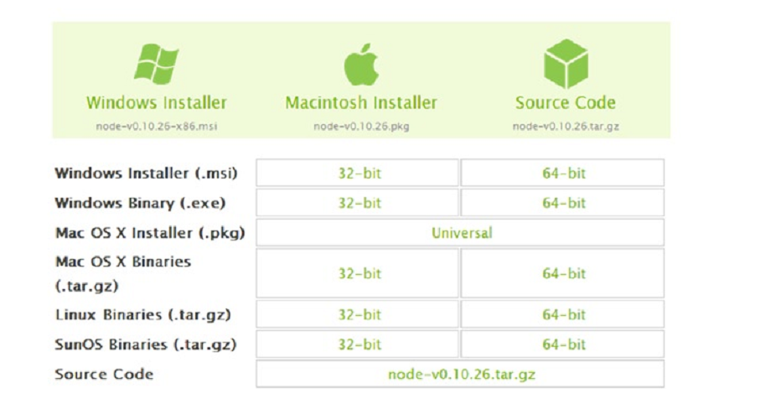
Install Node .js
Down load installers from http://nodejs.org/download/

Slide 5
Features............
Modularity
Core functionality is kept to a minimum .
Pick & install third party modules as required.
Node package manager (npm) manages packages/modules.

Slide 6
Features
Node JS supports Non-blocking, Asynchronous IO
IO processing takes more time
Permitting other processing to continue
before the transmission has finished.

Slide 7
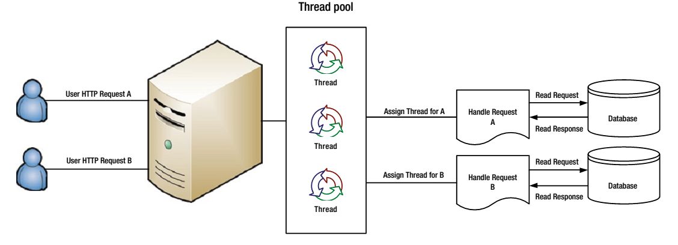
Traditional Web Application Processing Model [Mutithreaded]
Notes:
Thread T-n takes more time to interact with external systems, does necessary steps and prepares Response-n and send it back to the Server
Web Server in-turn send this Response-n to the Client-n.
When threads are busy with Blocking IO Tasks for longer time,
then remaining clients should wait longer time.

Slide 8
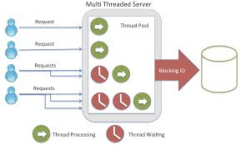
High memory usage,Thread waiting

Slide 9
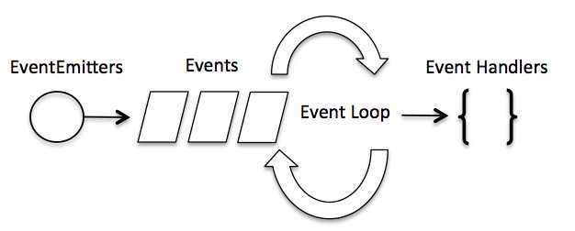
Event-Driven Asynchronous Platform
Main loop listens for events, and then triggers a callback function when one of those events is detected.

Slide 10
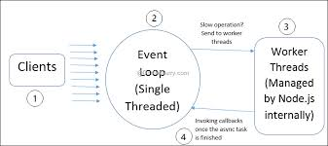

Slide 11
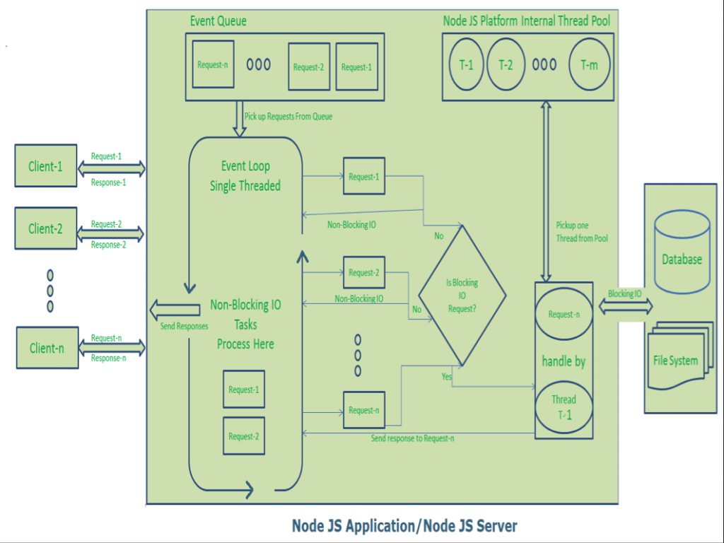
Node.js Processing Model
Notes:
Thread T-n takes more time to interact with external systems, does necessary steps and prepares Response-n and send it back to the Server
Web Server in-turn send this Response-n to the Client-n.
When threads are busy with Blocking IO Tasks for longer time,
then remaining clients should wait longer time.

Slide 12
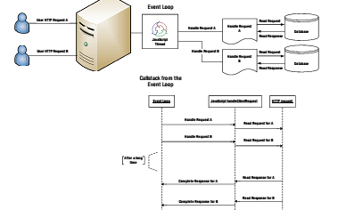
The Nginx way:
Notes:
Thread T-n takes more time to interact with external systems, does necessary steps and prepares Response-n and send it back to the Server
Web Server in-turn send this Response-n to the Client-n.
When threads are busy with Blocking IO Tasks for longer time,
then remaining clients should wait longer time.

Slide 13
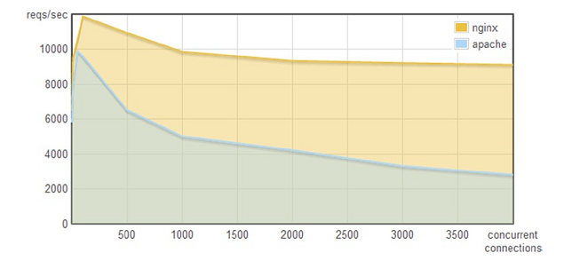
Single-threaded web server handles tons of concurrent requests.
Notes:
Thread T-n takes more time to interact with external systems, does necessary steps and prepares Response-n and send it back to the Server
Web Server in-turn send this Response-n to the Client-n.
When threads are busy with Blocking IO Tasks for longer time,
then remaining clients should wait longer time.

Slide 14
Call backs
Functions called at the completion of a given task.
Node makes heavy use of callbacks.

Slide 15
Synchronous IO:
var fs = require("fs");
var data = fs.readFileSync('input.txt');
console.log(data.toString());
Asynchronous IO:
var fs = require("fs");
fs.readFile('input.txt', function (err, data) {
if (err) return console.error(err);
console.log(data.toString());
});

Slide 16
Users :
Wall Mart
Yahoo
Linked In
Paypal etc...

Slide 17
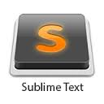





IDES for Node

Slide 18
References:
http://www.tutorialspoint.com/nodejs/index.htm
http://www.journaldev.com/7397/introduction-to-node-js-basics
http://blog.carbonfive.com/2013/10/27/the-javascript-event-loop-explained/
Books: Wrox Proffessional Node.JS
Appress Beginning Node.js

Slide 19
Thank you
Notes:
<number>

